Slide 1

Rhino VSA
Dima Ionut Daniel

Slide 2
Contents
What is Rhino VSA?
FSM
VSA Features
Basic Concepts
VSA GUI
VSA Channel
FSM Element
FSM Diagram
Flowcharts
State elements
Transitions
Actions
Conditions
FSM Dictionary
Component Repository
Generate artifacts
Creating Services
Manage deployments
Conclusions
Bibliography

Slide 3

What is Rhino VSA?
OpenCloud's Visual Service Architect (VSA) is a GUI-based service-creation environment that is used for SLEE application development.
VSA is focusing on the application-development processes.
Before VSA, SLEE services had to be produced through a careful semi-manual process.
VSA can be used to create SLEE services using diagrams based on the FSM(Finite State Machine).
VSA can be used to deploy SLEE services.
VSA can be used for management opreations like: activating, deactivating services, creating RA entities and managing an RA deployment.
VSA can generate service implementation code, deployment descriptors and depoyable units.

Slide 4
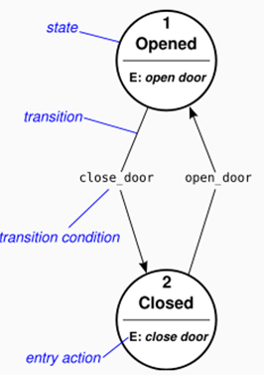
FSM
OpenCloud's FSM Tool is a lightweight service-creation tool designed to simplify service creation for the Rhino SLEE.
An FSMTool FSM is a hybrid state machine model.
It incorporates features of both Moore and Mealy FSMs.
FSMTool FSMs use three types of actions:
input (like a Mealy machine)
entry (like a Moore machine)
exit (an additional feature, useful for application requirements such as canceling timers)
The states are "Opened" and "Closed".
The transitions are "close_door" and "open_door".
The actions are "open door" and "close door"

Slide 5
VSA Feature
VSA offers following features:
Writing applications using FSM.
Integration with Rhino.
Integrating into build Envirnoment as it generated ant based buil.xml files.
Bundled Protocol support: CAP, CDR, CGIN, Diameter, HTTP, JSIP, MAP, SOAP, Telnet,etc.
Re-Use: integrated repositories of re-usable artifacts.
Correctness: VSA continuosly monitors your work and checks it for correctness
Team-based software development: bundled support for Subversion.

Slide 6
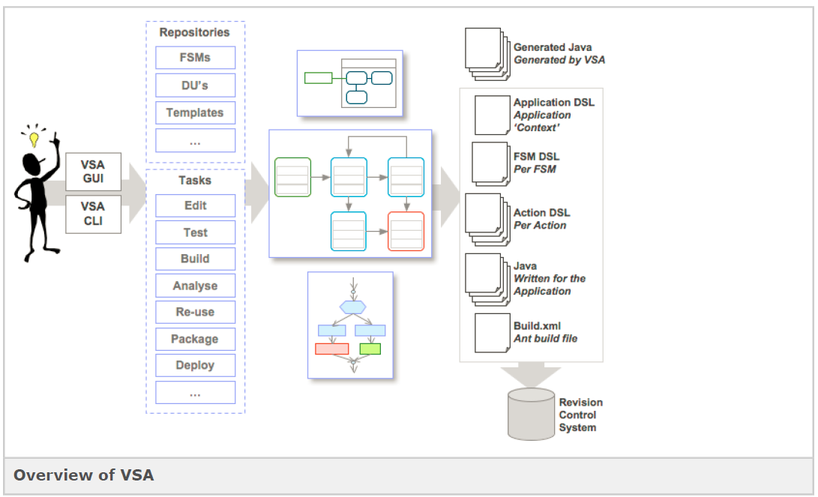
VSA Feature (cont.)

Slide 7
Basic Concepts
VSA GUI

Slide 8
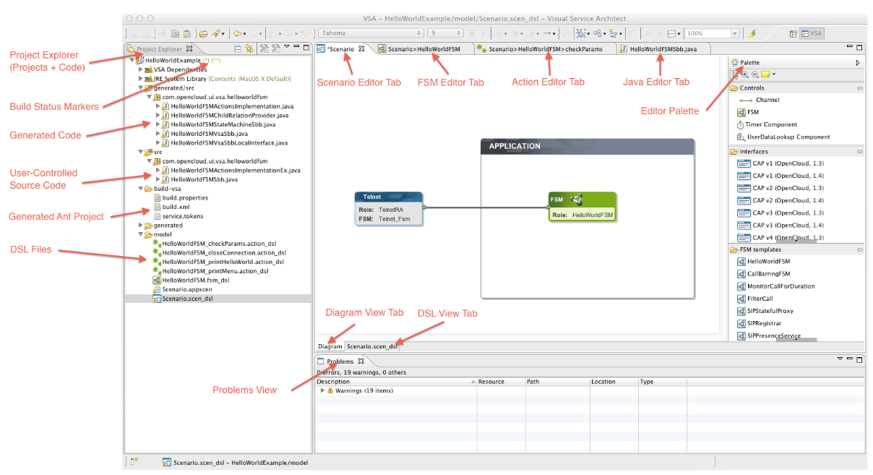
VSA GUI

Slide 9
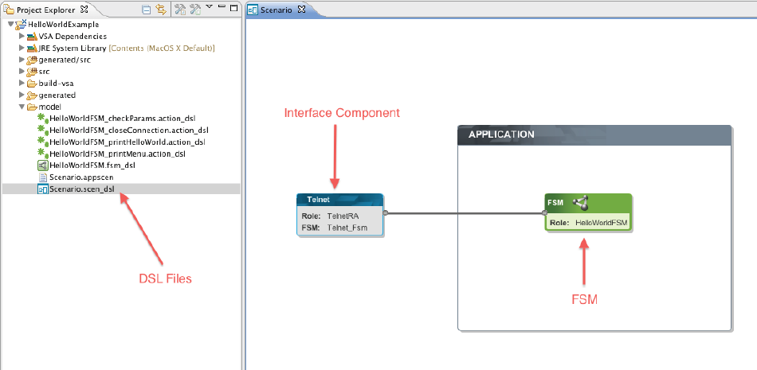
VSA GUI (cont.)

Slide 10
Basic Concepts
VSA Channel

Slide 11
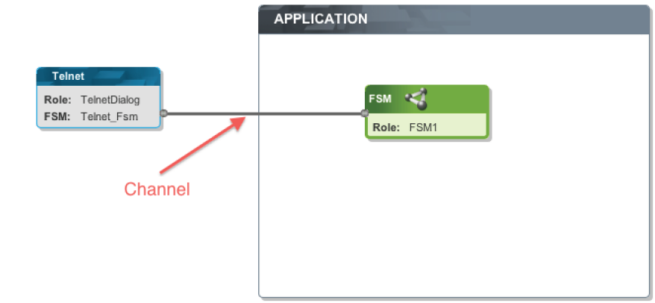
VSA Channel
Channels are the communication pipelines between the diagram elements.
For a channel to be correctly configured, each of its ends must be associated with one of the endpoints of the connected components.

Slide 12
Basic Concepts
FSM Element

Slide 13
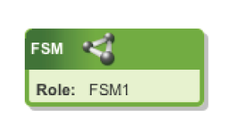
FSM Element
The FSM element represents a Finite State Machine component within the service scenario design.
FSM properties:
Name - role name of the FSM.
Package prefix - package name used as a prefix when generating code for this FSM.
Sbb base class - name of a base class which the VSA-controlled Sbb abstract class extends.
Initial-Event-Selector - One of: ACTIVITY_CONTEXT, ADDRESS, ADDRESS_PROFILE, EVENT, EVENT_TYPE,METHOD.
SbbID - The ID of the Sbb to which this FSM is mapped. If empty, a default ID will be generated when required.
DSL file - The project-relative path to the file where the FSM's DSL file shall be located.
ActionImpl. Class - The project-relative path to the file where the FSM's

Slide 14
Basic Concepts
FSM Diagram

Slide 15
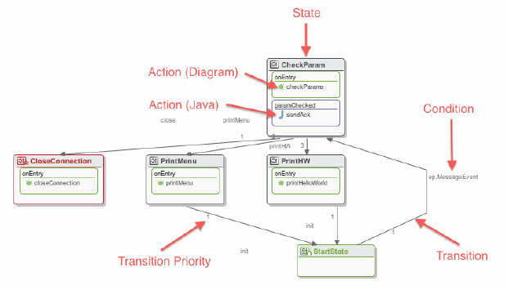
FSM Diagram
FSM stands for Finite State Machine.
FSM diagrams in VSA are visual representations of the FSM concept introduced by FSM Tool.
They consist of a set of states which are connected by conditional transitions.
Each state has sets of actions which are called at certain stages in the FSM execution algorithm.

Slide 16
Basic Concepts
Flowcharts

Slide 17
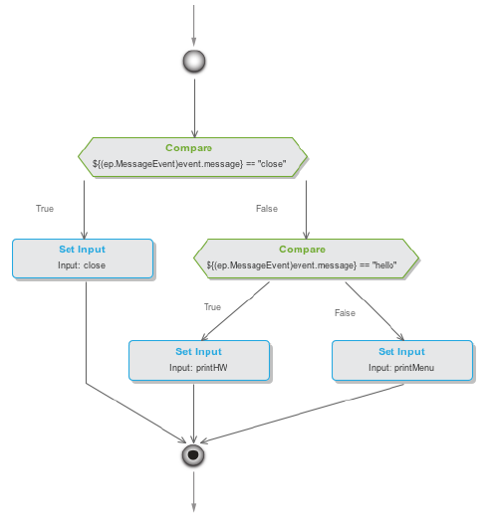
Flowcharts
Action flowcharts represent user-defined implementations of actions from FSM diagrams.
They contain a set of flowchart elements which are executed sequentially when the containing action is executed during the FSM execution algorithm.

Slide 18
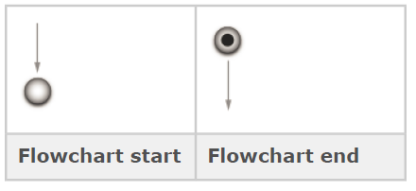
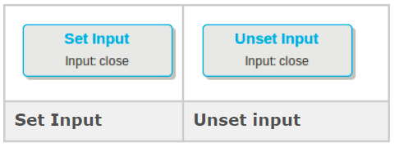
Flowcharts (cont.)
The action flowchart start and end represent the entry and exit points of the control flow, from the point where the FSM execution algorithm invokes the action.
Set Input can be used to raise an FSM input for the next execution round of the FSM.
Unset Input can be used to lower an FSM input for the next execution round of the FSM.

Slide 19
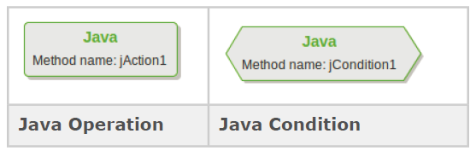
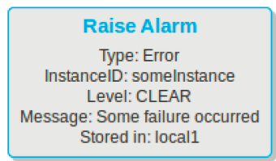




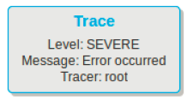

Flowcharts (cont.)
SendOutput represents an attempt by the current FSM to communicate with another component in the application scenario.
Java Operations give you complete control over a section of the generated code.
Java Conditions are similar to Java Operations, but split into true and false branches
The Assign element can be used to read values from various sources and write them to a certain target.
The Trace element can be used to write debug or error output into the service's logs.
The Raise-Alarm and Clear-Alarm elements can be used to raise and clear alarms in the SLEE.
Contains elements represent a conditional branching point of the flowchart.

Slide 20
Basic Concepts
State Elements

Slide 21
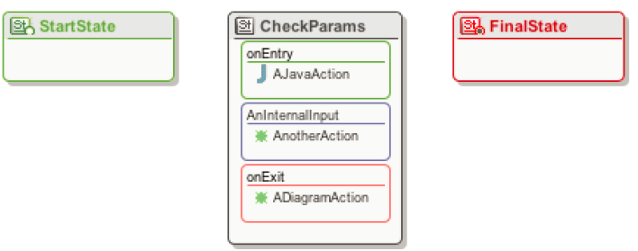
State Elements
State represents “situations” in which a certain set of actions are executed.
Each state contains three (3) sections:
entry actions — executed upon entering the state by way of a transition
exit actions — executed upon leaving the state by way of a transition
input actions — conditional executions (see Input Actions), which work as if transitioning from the state to itself.

Slide 22
Basic Concepts
Transitions

Slide 23
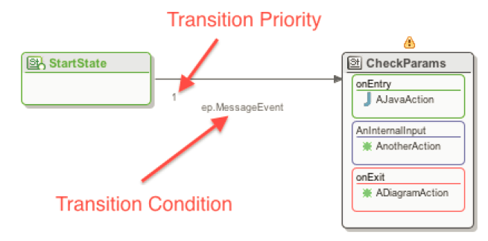
Transitions
Transitions are used to connect states.
Each transition carries a condition that specifies when to move from one state to another.
To configure a transition's condition, double-click the label with the textual representation of the
Condition or the line representing the transition connection, in the diagram.

Slide 24
Basic Concepts
Actions

Slide 25
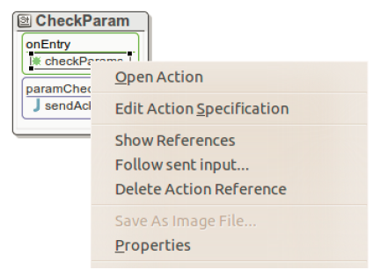
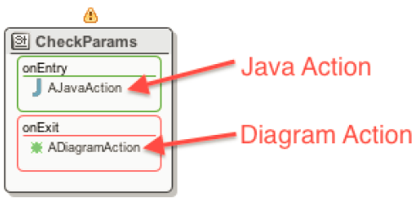
Actions
Actions have a set of user-defined instructions to execute when triggered — as exit actions, entry actions, or part of an input action.
Actions can be created using a VSA action flowchart sub-diagram or completely in Java.
VSA jumps directly into the Java Code Editor, with the cursor correctly positioned.
The same action can be called from multiple states, or even different action compartments of the same state.

Slide 26
Basic Concepts
Conditions

Slide 27
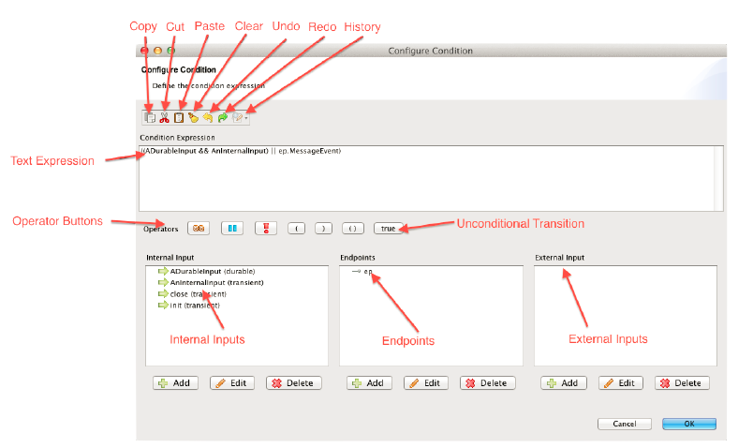
Conditions
Conditions are FSM inputs or Boolean combinations of FSM inputs (using operators && or ||).
They appear in transitions or input actions.
Conditions can be set to the special value Unconditional, which indicates that the transition is supposed to occur always.

Slide 28
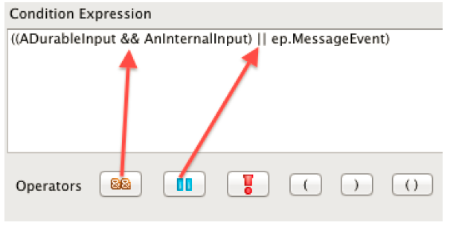
Conditions (cont.)
In the condition expression field we can type in any FSM Tool-conform conditional expression directly as text.
VSA automatically validates the expression and provides feedback if it contains syntax errors.
The operator buttons can be used to insert the characters for the corresponding operation into the condition expression field.

Slide 29
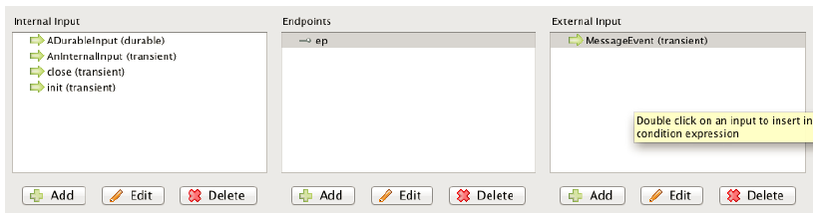
Conditions (cont.)
The cut/copy/paste buttons can be used to easily duplicate or move sub-expressions in the condition expression field.
The lists of internal and external inputs can be used to quickly access existing inputs and insert their textual representation at the current cursor position into the condition expression field.

Slide 30
Basic Concepts
FSM Dictionaries

Slide 31
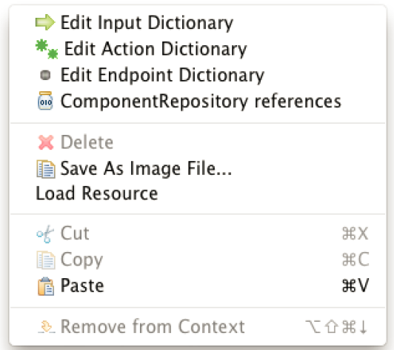
FSM Dictionaries
An FSM contains four distinct types of dictionaries:
Input
Action
Endpoint
Component repository references.
In order to edit right-click the FSM Diagram background and select which you want to edit from the popup menu.

Slide 32
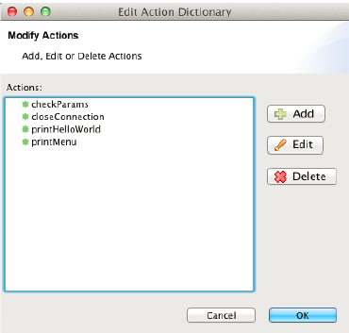
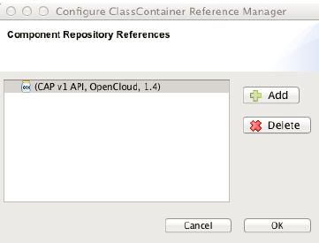
FSM Dictionaries (cont.)
The Input dictionary contains a list of all external and internal input s which are currently declared on the FSM.
The Action dictionary contains a list of all actions which are currently declared on the FSM and can be of one of this types:
Diagram action – flowchart sub-diagram that define the action behaviour.
Java action – java code
The Endpoint dictionary contains a list of all the endpoints which are currently declared on the FSM.
The Component repository references dictionary contains a list of all the user-defined extra dependencies to modules in the Component Repository.

Slide 33
Basic Concepts
Component Repository

Slide 34
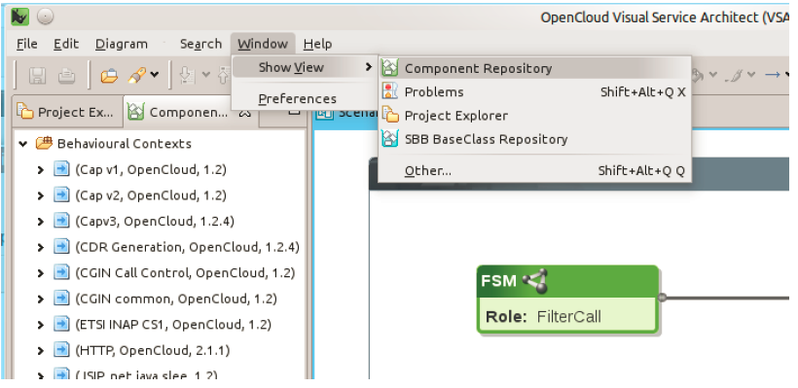
Component Repository
The component repository contains:
JSLEE Deployable Units that contain RA-Types, EventTypes, RAs, Sbbs, ProfileSpecs and Libraries.
Interface Definitions and their groupings of:
one or more RA-Types
a set of FSMs describing protocol behaviour
a symbolic name/vendor/version triplet (to use as ID for the Interface Definition).

Slide 35
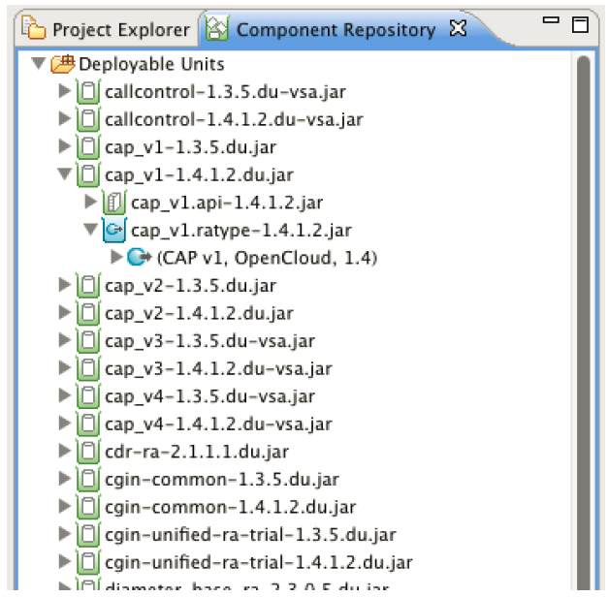
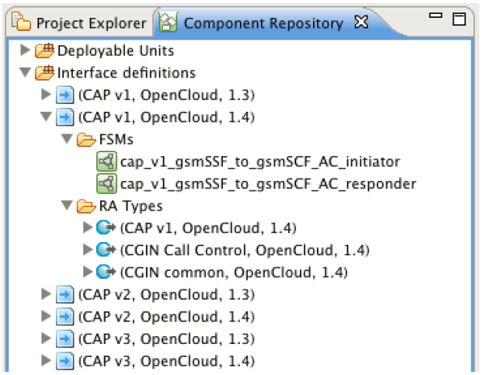
Component Repository (cont.)
The VSA install package comes with a pre-populated component repository, which contains an OpenCloud-provided set of RA-types and example components.

Slide 36
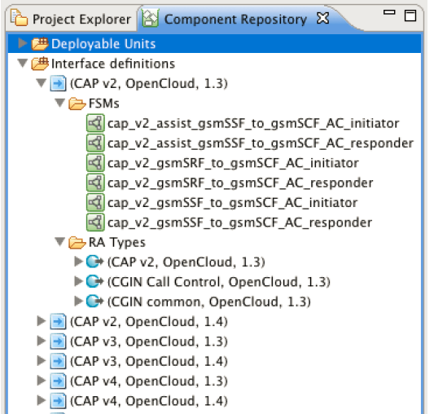
Component Repository (cont.)
Applications developed with VSA can use the SLEE Deployable Units (DUs).
Interface Definitions depend on the DUs in the component repository.
Any SLEE Deployable Unit can be imported into the DU section of the Component Repository as long as it is SLEE-1.1 compliant.
An interface definition is a grouping of:
one or more RA-types.
a set of FSMs describing protocol behaviour.
a symbolic (name, vendor, version) triplet to use as the ID for the interface definition.

Slide 37
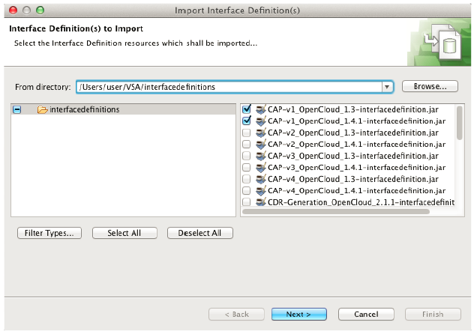
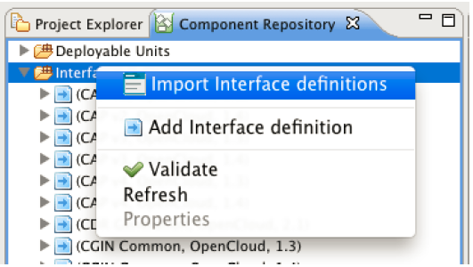
Component Repository (cont.)
Interface definition jars that adhere to the interface definition jar import format can be imported directly into VSA.

Slide 38
Basic Concepts
Generate artifacts

Slide 39
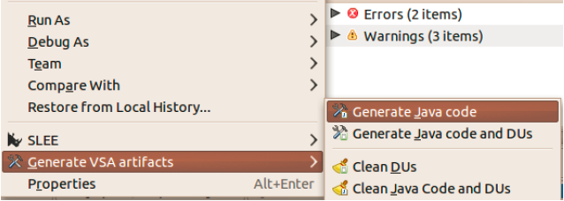
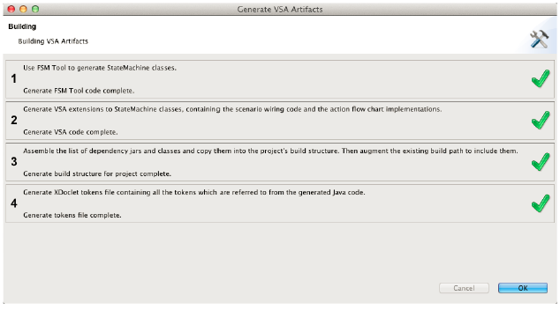
Generate artifacts
VSA can generate artifacts

Slide 40
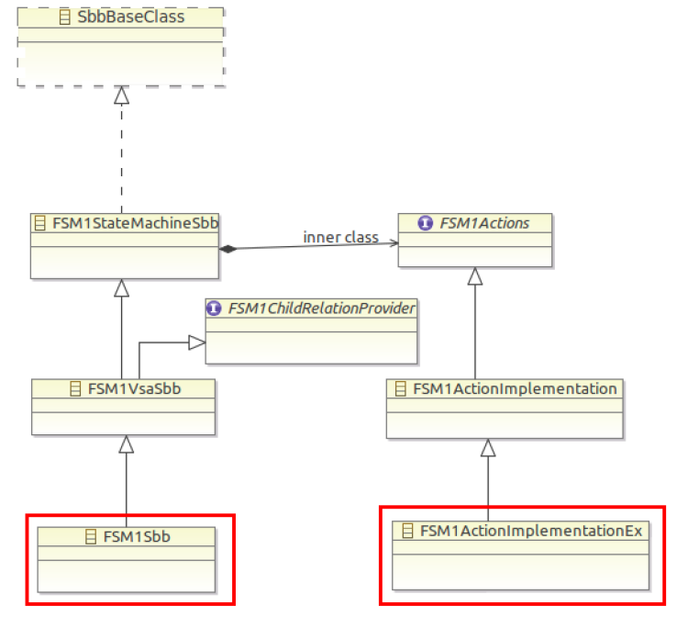
Creating Services
VSA code generation builds on top of these classes that FSM Tool generates:
VSA-controlled Sbb abstract class, extending the state machine abstract class
VSA-controlled Action Implementation class, extending the Action Interface

Slide 41
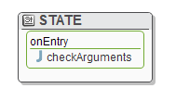

Creating Services (cont.)
Actions implementation methods needs to be implemented using custom code.
Each java FSM action has to be provided action implementation.
All SLEE Facilities can be obtained through facilities provided object.
Inputs object provides access to all FSM defined inputs.
Endpoints object provides access to all FSM defined endpoints.
FSMActionsImplementationEx.java

Slide 42
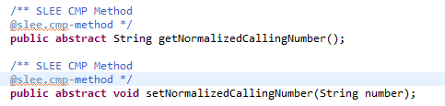
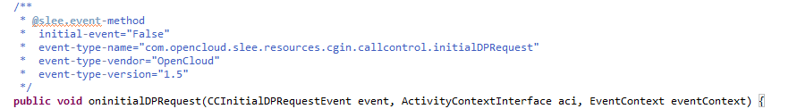
Creating Services (cont.)
SLEE deployment descriptors
VSA generates SLEE deployment descriptors(DDs) for the project's SLEE service and each FSM/Sbb, based on OC XDoclet tags from the FSMs' Java source code. It stores these DDs in the generated/fsm-infos/<FSM_name>/META-INF_ directories.
Xdoclet tags can be used by the devloper in FSMSbb class, to add specific information to generated deployment descriptor (e.g. add CMP field)
Example event handler method Xdoclet tags

Slide 43
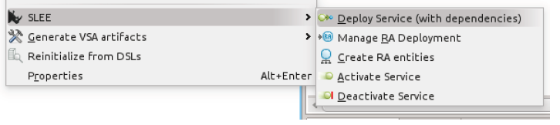
Manage Deployments
Deploying/undeploying services to and from SLEE
Same or different host (access through Managemnt API)
VSA determines all dependencies
VSA includes dependencies into deployment sequence
VSA checks dependency deployments conflicts (Bump version, Ignore or Replace)

Slide 44
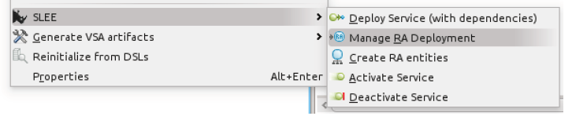
Manage Deployments (cont.)
Deploy service deploys only RA Types!
RA Deployment allows to deploy RA Implementation
Other management operations are:
Create RA entities of specified type.
Configure RA entity properties.
Activate/deactivate service.

Slide 45
Conclusions
VSA is free.
VSA issues can be reported and in future will be fixed.
VSA plugin for Eclipse is available. VSA is focusing on the productivity.
VSA components templates can be reused.

Slide 46

Bibliography
Visual Service Arhitect – Overview and Concepts.pdf
Visual Service Arhitect – User Guide.pdf

